Slide 1

Leadership Under Pressure
Mapping Your Default Pattern & Expanding Your Capacity
Notes:
Good evening everyone and welcome.
Thank you for taking the time to be here. Leadership today is not easy.
The pressure on leaders has increased enormously over the last decade — whether that’s running organisations, managing teams, or simply trying to hold everything together.
And one of the things I’ve noticed through my work with leaders over the years is that pressure tends to reveal patterns.
Not the patterns we want people to see — but the ones that appear when things get difficult.
Through making the documentary Boarding on Insanity and through my work with leaders over the past 10 year, one theme kept appearing again and again.
Many high-performing people learned very early in life to push through, suppress emotion, and keep going.
And that can work for a while. But over time it creates a cost — in relationships, decision making, and personal wellbeing. So today I’d like to explore something quite simple.
When pressure rises:
What actually happens inside us?
And more importantly:
How can leaders expand their capacity so that pressure doesn’t shrink their thinking, their relationships, or their effectiveness?
So in the next hour we’re going to do three things together.
1. We’ll identify the triggers that activate us.
2. We’ll map the default pattern that tends to follow.
3. And then we’ll explore how leaders can begin to create a different response — one that brings more clarity, more presence, and more capacity under pressure.
Use this time as a space to improve your leadership.

Slide 2
Objectives for our time together
Identify your trigger
Map your default pattern
Understand the cost
Design a new response
Notes:
Clarity reduces anxiety.

Slide 3
Who we are

Slide 4
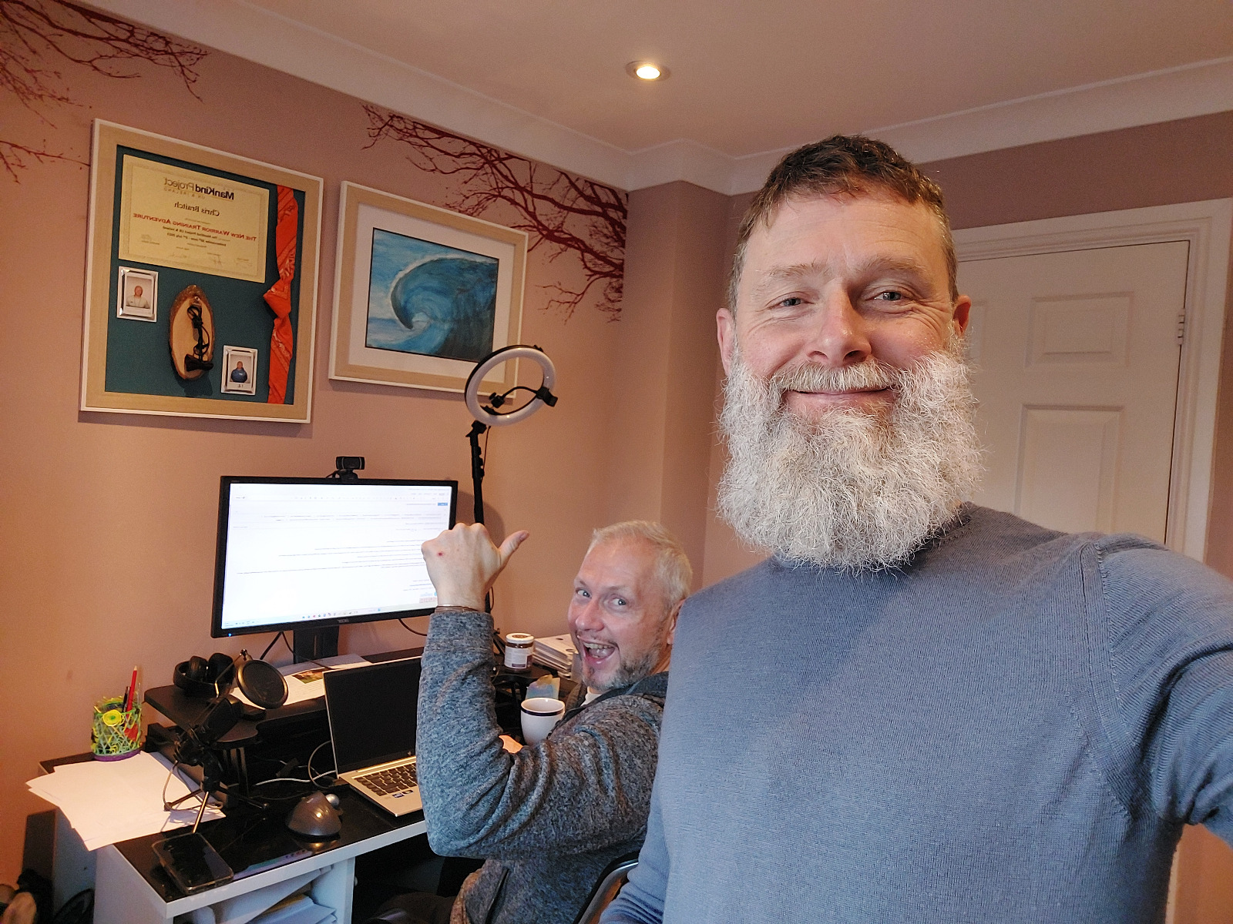
Coaches and leaders with a vision
Piers Cross is an author, a filmmaker and a leadership coach specialising in the area of peak performance, and trauma, especially boarding school. He also runs a podcast around these themes, called An Evolving Man. He has produced and released a documentary ‘Boarding On Insanity’
Chris Braitch has a mission to move himself and the world around him towards connection and compassion. He works as an emotional health coach, leadership coach with Compassionate Leaders Global, and as a founding director of not-for-profit Seen & Heard

Slide 5
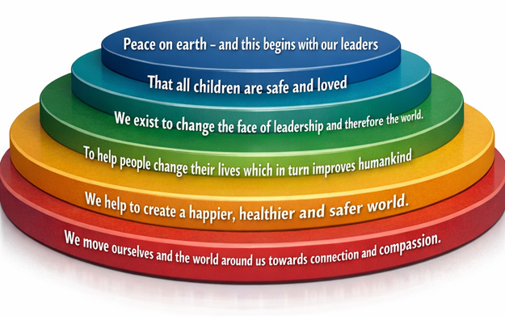
Coaches and leaders with a vision

Slide 6
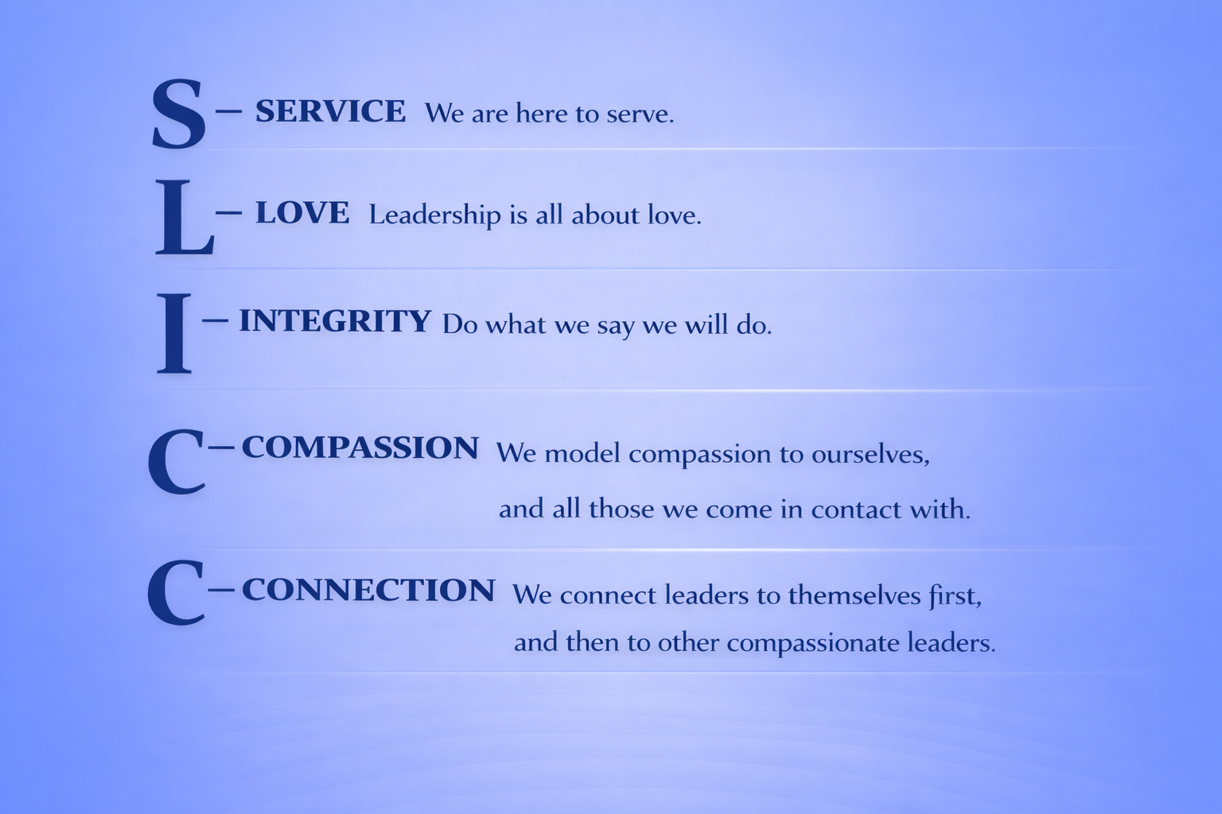
Coaches and leaders with a vision

Slide 7

Our time together today
Some theory, keeping it light
Some personal exercises to complete
If you haven’t already please have the workbook ready
Please add questions, ideas and experiences into the chat
https://compassionateleadersglobal.com/services/training-workshops-speaking/workshop-resources/

Slide 8
Let’s arrive together…

Slide 9
The Reality
Pressure doesn’t build character…
It reveals conditioning
Notes:
“Most of us like to believe that pressure strengthens us.
In reality, pressure exposes the patterns we’ve never examined.”
“Just out of curiosity — how many of you feel that leadership pressure has increased significantly over the last few years?”

Slide 10
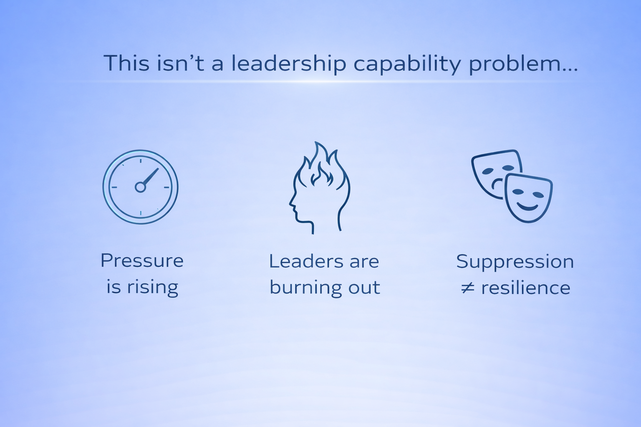

Slide 11
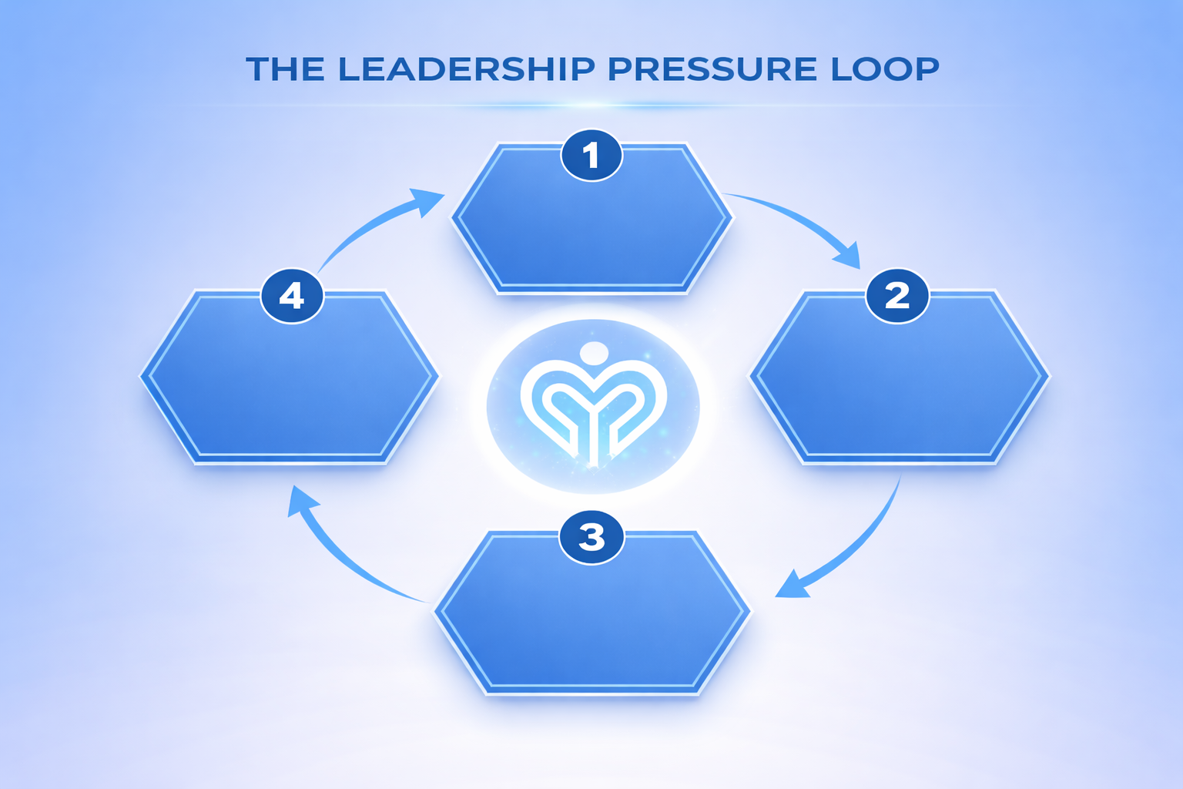





Slide 12
SECTION 2
WHAT HAPPENS UNDER PRESSURE
Notes:
“Under pressure, we do not rise to the occasion. We rise or fall to the level of our training.” Urban Meyer

Slide 13

The Nervous System Under Load
Notes:
Fight - maybe we get angry. We shout at our team
Flight - we run away - leaving the work to others
Freeze - the brain stops working - not sure what to do
Fawn - Please Appease - be the people pleaser - try to get everyone on board - so much so that nothing is achieved.

Slide 14
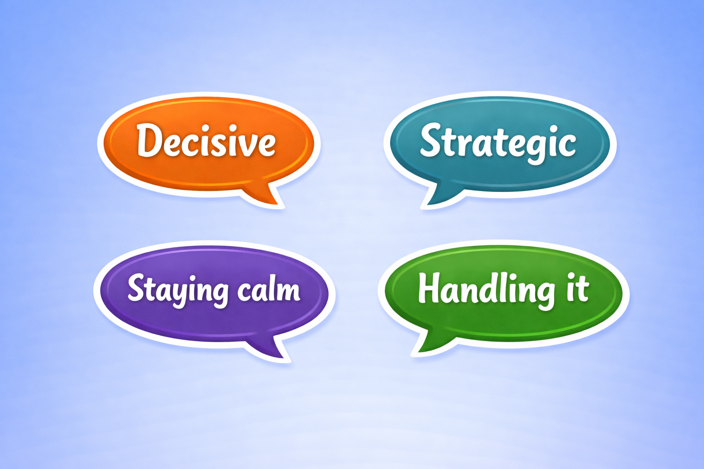
What Leaders Call It

Slide 15
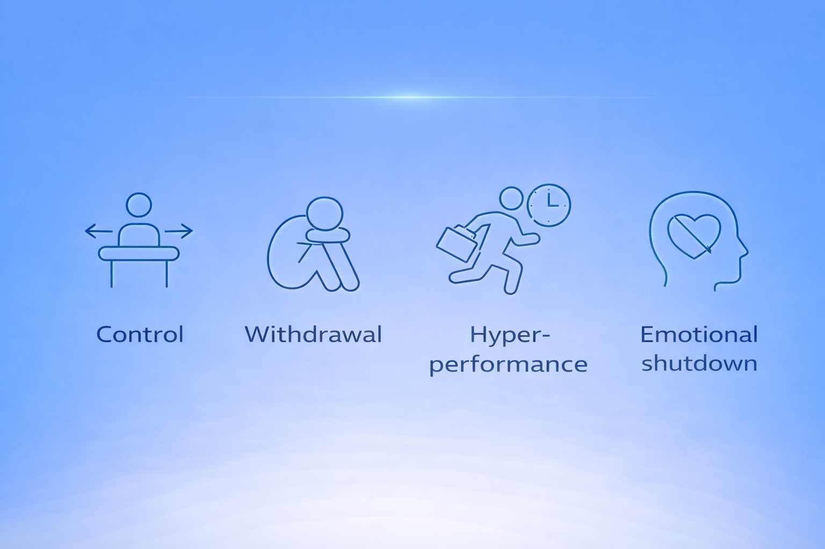
The Default Patterns
Notes:
Which one feels familiar?

Slide 16
SECTION 3
EXERCISE 1
THE TRIGGER MAP
Notes:
“When pressure rises for you as a leader, do you tend to push harder, withdraw slightly, or try to control the situation?”

Slide 17
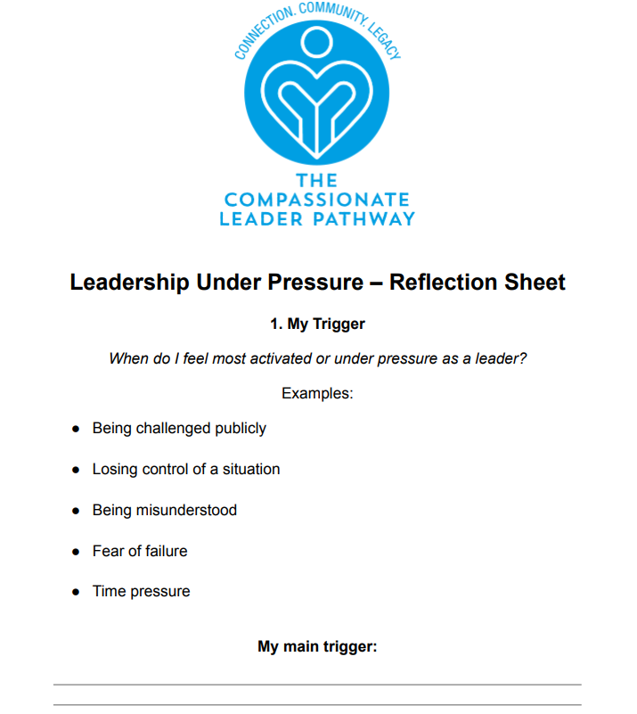
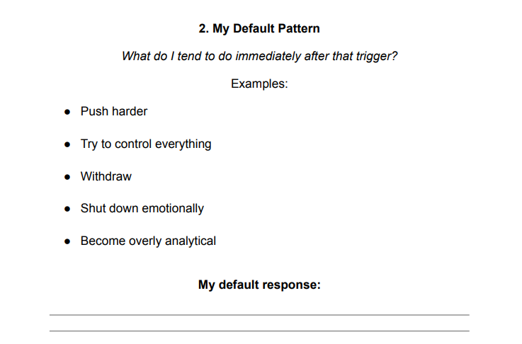
Identify Your Trigger - Use your worksheet
Notes:
Pause 5–7 mins.
https://compassionateleadersglobal.com/services/training-workshops-speaking/workshop-resources/

Slide 18
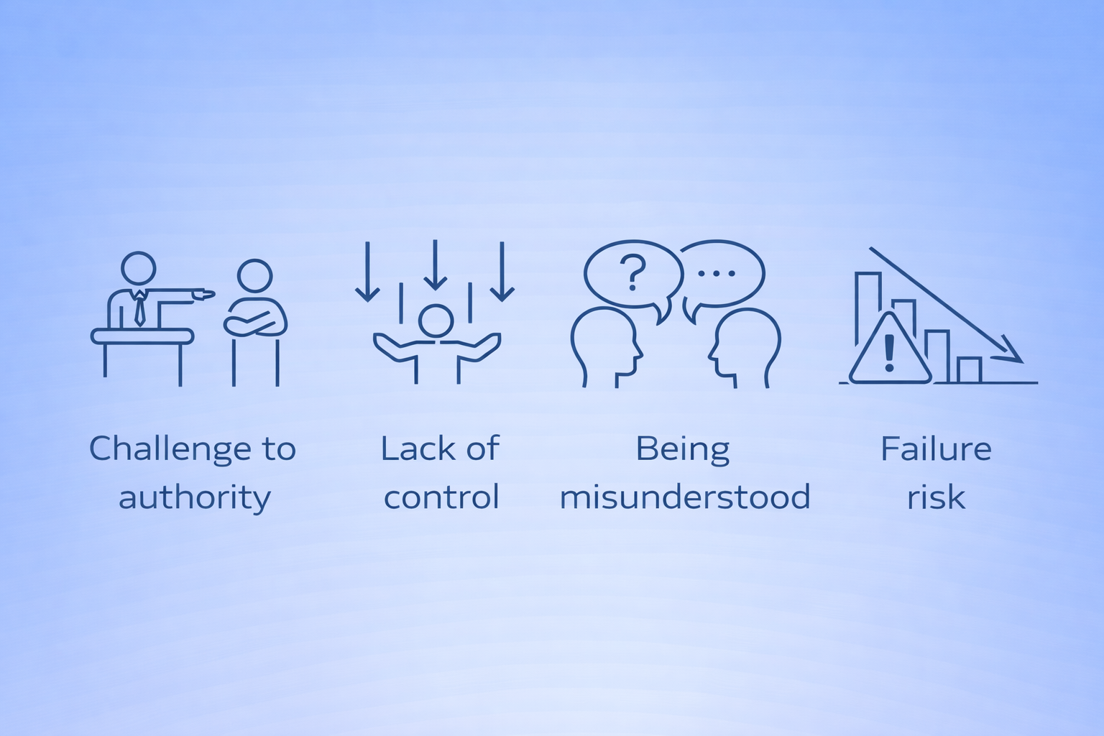
When do I feel most activated as a leader?
Notes:
Use worksheet here: https://compassionateleadersglobal.com/services/training-workshops-speaking/workshop-resources/

Slide 19
What happens immediately after the trigger?
Notes:
Colette Easton - Man-Ager - the different ways leaders react - interrupting people, taking up space in the office or meeting area, getting angry

Slide 20
SECTION 4
THE COST

Slide 21
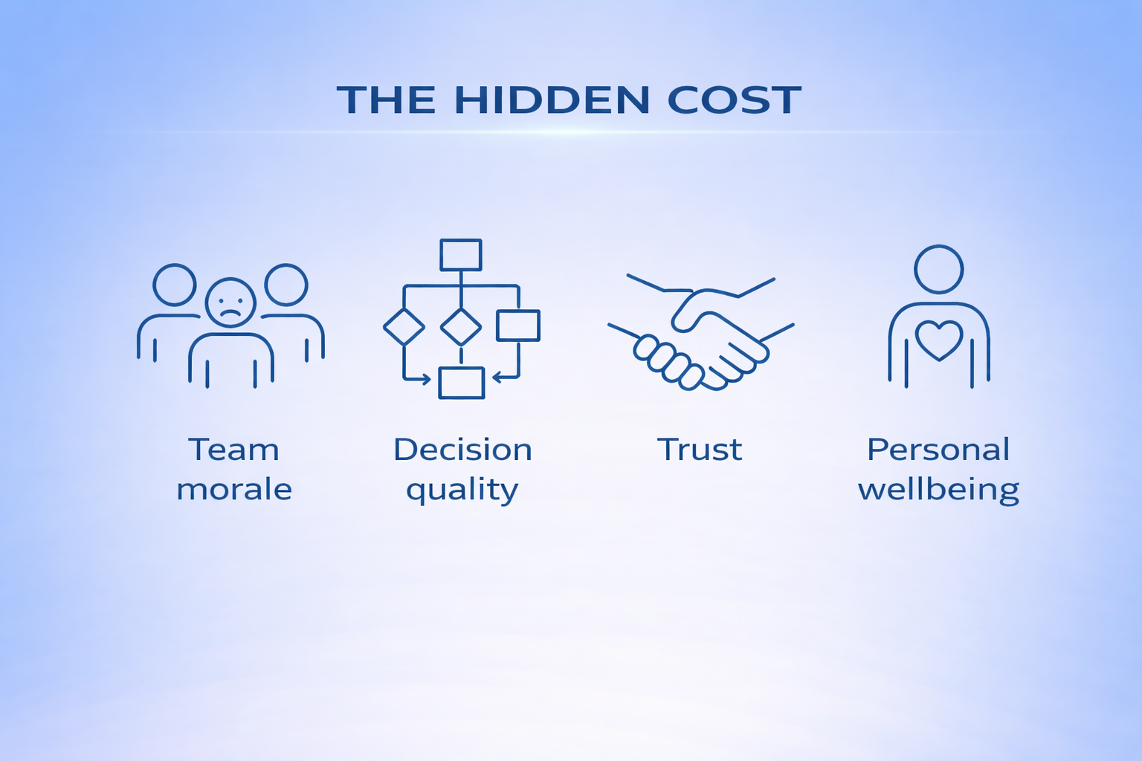

Slide 22
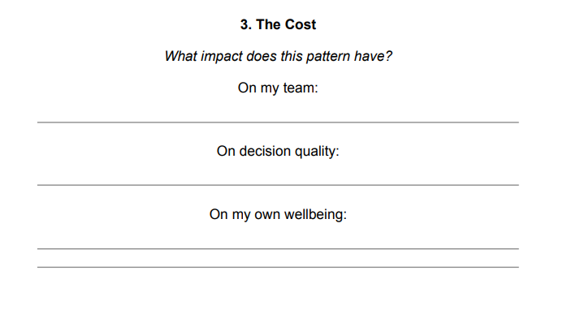
The cost to you - Use your worksheet
Tight body
Shortened thinking
Emotional fatigue
Distance from values
Notes:
“What does this pattern cost me?”
Use worksheet here: https://compassionateleadersglobal.com/services/training-workshops-speaking/workshop-resources/

Slide 23
SECTION 5
EXPANDING CAPACITY

Slide 24
Regulation ≠ Suppression
Suppression = Pushing emotion down
Regulation = Staying present with it
Notes:
“Which pattern is your default?”

Slide 25
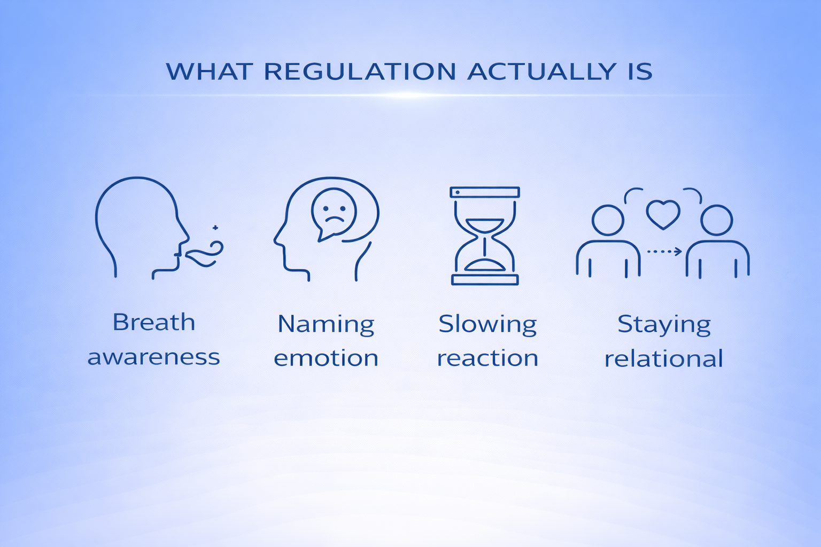
Notes:
The best public speakers, pause between sentences, they speak slowly. Inner critic - many leaders

Slide 26
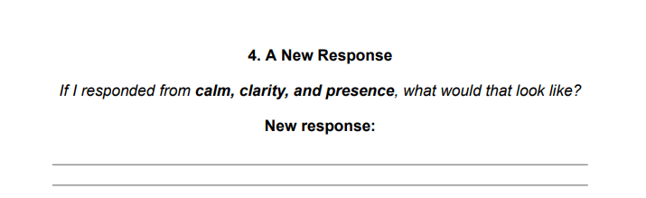
The New Pattern Design - Use your worksheet
Notes:
Use worksheet here: https://compassionateleadersglobal.com/services/training-workshops-speaking/workshop-resources/

Slide 27
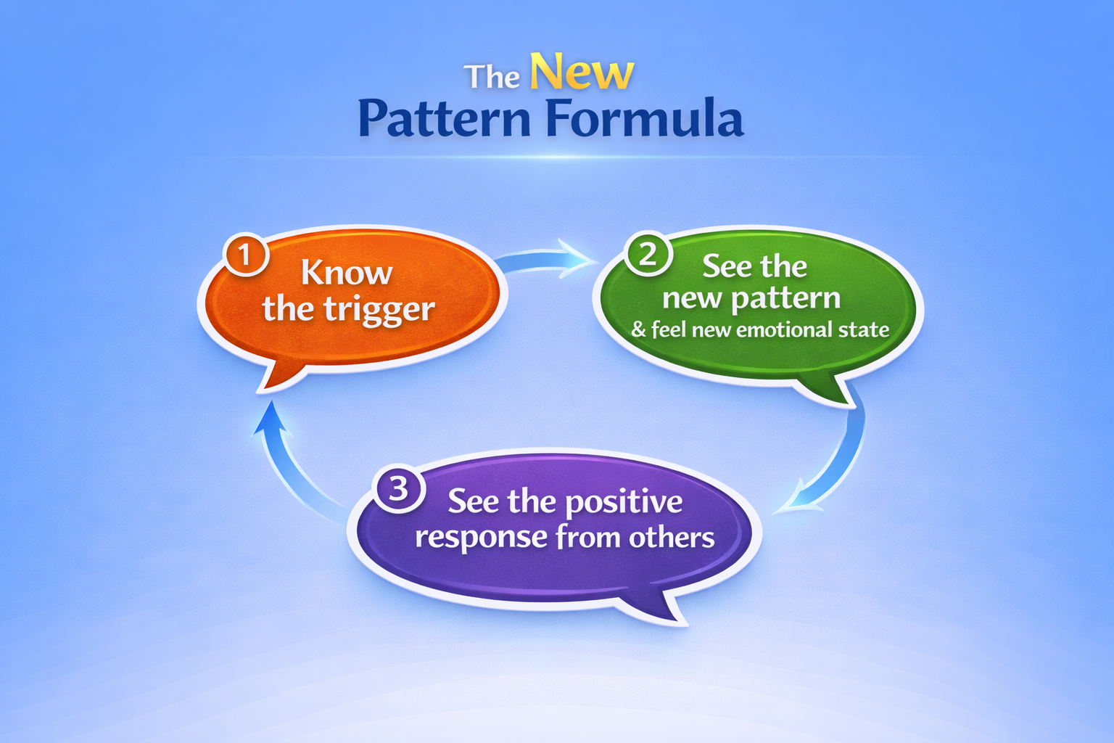

Slide 28
Guided Practice
New Pattern Formula
Guided 2 minutes visualisation
Notes:
I’m going to guide you through a very short two-minute reflection.
Ask to imagine:1️⃣ The trigger 2️⃣ The new response 3️⃣How does it feel and what is the response you want from others.
WOOP - If then implementation

Slide 29
SECTION 6
INTEGRATION
Notes:
“If your leadership capacity under pressure increased even by 20%, what difference would that make for your work or your team?”

Slide 30
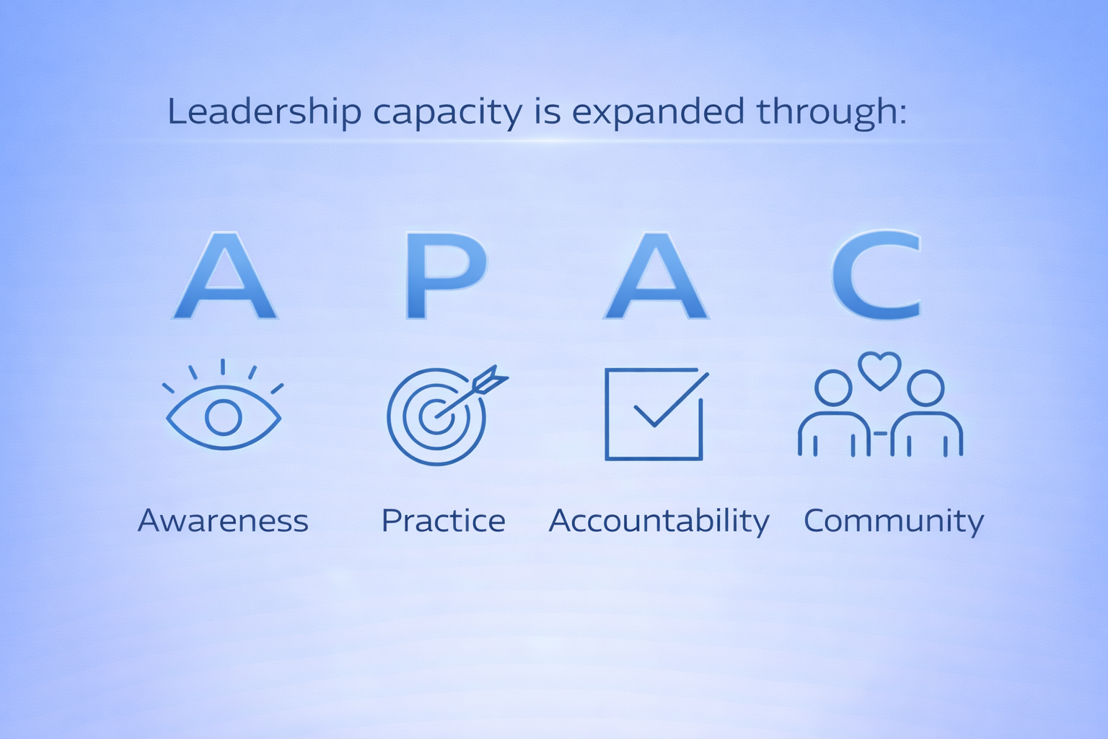
Capacity Is Trainable
Notes:
Before we finish, I’d like you to reflect on one question.
If the pattern you identified today continued for the next five years…
What would the cost be?
For your leadership.
For your relationships at work.
And for your own wellbeing.
Because the reality is that leadership capacity doesn’t expand automatically.

Slide 31
If This Resonates…
You may be noticing:
Pressure reveals patterns
Leadership capacity can grow
Regulation changes relationships
Notes:
Story Council Leaders: Passionate man. Did some breathing and regulation before sending email.

Slide 32
If This Resonates…
The real question becomes:
How do you practice this consistently?
Notes:
“If your leadership capacity under pressure increased even by 20%, what difference would that make for your work or your team?”

Slide 33
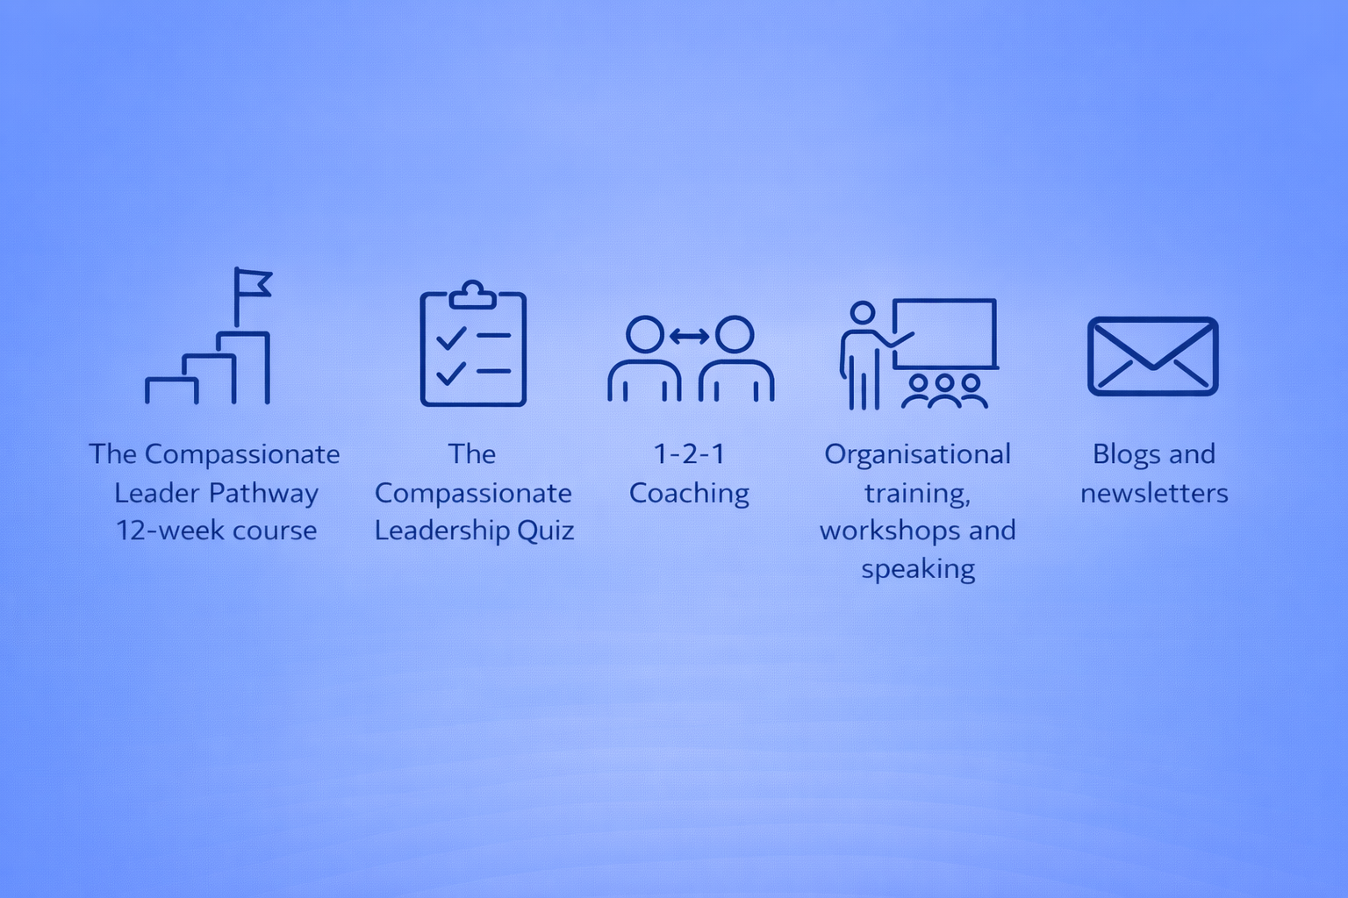
If This Resonates…
12 weeks - Online
Accountability buddies
Weekly Q&A and Check In Circles
Legacy Programme
Notes:
For those of you who want to go deeper with this work, Chris Braitch and I run a 12 week programme focused on one thing: helping leaders expand their capacity under pressure.
We use a structured pathway — but the focus is practical, grounded, and applied to real leadership situations.
https://compassionateleadersglobal.com/the-compassionate-leader-pathway-course/

